Slide 1

UNIT 1 : CONCEPTS OF NOSQL : MONGODB
Concepts of NoSQL. Advantages and Features
MongoDB Data Types (String, Integer, Boolean, Double, Arrays, Objects)
Database Creation and Dropping Database
Create and Drop Collection
CRUD Operations (Insert, Update, Delete, Find, Query and Projection Operators)
Operators (Projections, Update, Limit(), sort() and Aggregation Commands)

Slide 2
1.1 Concepts of NoSQL. Advantages and Features
1.1.1 MongoDB Data Types Integer, Boolean, Double, Objects)
(String, Arrays,
1.1.2 Database Creation and Dropping Database

Slide 3
Introduction
A NoSQL (Not Only SQL or Not SQL) originally referring to non SQL or non relational is a database that provides a mechanism for storage and retrieval of data.
This data is modeled, it means other than the
tabular relations used in relational databases.
NoSQL are non-tabular databases and store data differently than relational tables. NoSQL databases come in a variety of types based on their data model. The main types are document, key-value, wide- column, and graph.

Slide 4
Carl Strozzi introduced the NoSQL concept in 1998.
Traditional RDBMS uses SQL syntax to
store and retrieve data for
further database
insights. Instead, a NoSQL system encompasses a wide
range
of
database technologies that can
store
structured, semi-structured, unstructured and polymorphic data.

Slide 5
Models of NOSQL Database
Key-Value pair-based databases.
Column-based databases.
Document-oriented databases.
Graph databases.

Slide 6
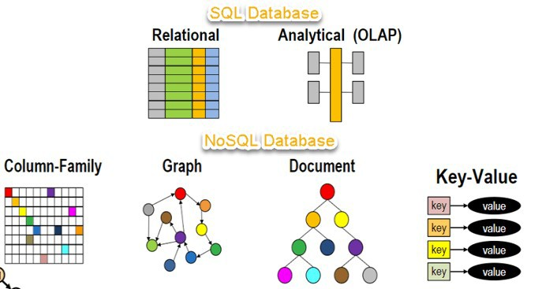

Slide 7
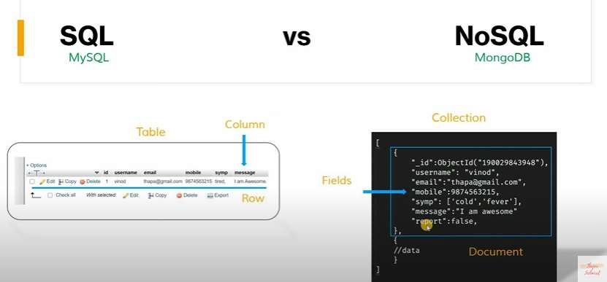

Slide 8
The concept of NoSQL databases became
popular with
Google,
Internet giants like
who The
Facebook,
Amazon, etc.
deal with huge volumes of data.
system response time becomes slow when you use RDBMS for massive volumes of data.
To resolve this problem, we could “scale
up” our
systems by hardware.
upgrading our
is
existing
This process
expensive.

Slide 9
History
1998- Carlo Strozzi use the term NoSQL for his lightweight, open-source relational database
2000- Graph database Neo4j is launched
2004- Google BigTable is launched
2005- CouchDB is launched
2007- The research paper on Amazon Dynamo is released
2008- Facebooks open sources the Cassandra project
2009- The term NoSQL was reintroduced

Slide 10
Advantages & Features
Support for Multiple Data Models
Easily Scalable via Peer-to-Peer Architecture
Flexibility: Versatile Data Handling
Distribution Capabilities
Zero Downtime

Slide 11
1. Support for Multiple Data Models
Where relational databases require data to be put into tables and columns to be accessed and analyzed, the various data model capabilities of NoSQL databases make them extremely flexible when it comes to handling data.
They can ingest structured, semi-structured, and unstructured data with equal ease, whereas relational databases are extremely rigid, handling primarily structured data.
Developers and architects choose a NoSQL database to more easily handle different agile application development requirements.

Slide 12
2. Easily Scalable via Peer-to-Peer Architecture
It’s not that Relational Database can’t scale, it’s that they can’t scale EASILY or CHEAPLY, and that’s because they’re built with a traditional master-slave architecture, which means scaling UP via bigger and bigger hardware servers as opposed to OUT or worse via sharding.
Sharding means dividing
a database into
smaller chunks across multiple hardware servers instead of a single large server, and this leads to operational administration headaches. Instead, look for a NoSQL database with a masterless, peer-to-peer architecture with all nodes being the same.

Slide 13
3. Flexibility: Versatile Data Handling
Where relational databases require data to be put into tables and columns to be accessed and analyzed, the multi-model capabilities of NoSQL databases make them extremely flexible when it comes to handling data.
They can easily process structured, semi-structured, and unstructured data, while relational databases, are designed to handle primarily structured data.

Slide 14
4. Distribution Capabilities
Look for a NoSQL database that is designed to distribute data at global scale, meaning it can use multiple locations involving multiple data centers and/or cloud regions for write and read operations. Relational databases, in contrast, use a centralized application that is location- dependent (e.g. single location), especially for write operations.
A key advantage of using a distributed database with a masterless architecture is that you can maintain continuous availability because data is distributed with multiple copies where it needs to be.

Slide 15
5. Zero Downtime
The final but certainly no less important key feature to seek in a NoSQL database is zero downtime. This is made possible by a masterless architecture, which allows for multiple copies of data to be maintained across different nodes.
If a node goes down, no problem: another node has a copy of the data for easy, fast access. When one considers the cost of downtime, this is a big deal.

Slide 16
MongoDB
MongoDB, the
most popular NoSQL
database, is an open-source document-
oriented database.
The term
‘NoSQL’
means ‘non-relational’.
It means that
MongoDB isn’t based on the table-like
relational database structure but provides an all
together different
mechanism for storage and retrieval of data. This format of storage is called BSON ( similar to JSON format).

Slide 17
SQL databases store data in tabular format. This data is stored in a predefined data model which is not very much flexible for today’s real- world highly growing applications. Modern applications are more networked, social and interactive than ever. Applications are storing more and more data and are accessing it at higher rates.

Slide 18
Download Link for MongoDB
SHELL
https://downloads.mongodb.com/compas s/mongosh-1.4.2-x64.msi
UI
https://fastdl.mongodb.org/windows/mo ngodb-windows-x86_64-5.0.8-signed.msi
https://fastdl.mongodb.org/windows/mo ngodb-windows-x86_64-5.0.9-signed.msi

Slide 19
1.1.1 MongoDB Data Types
String
Integer
Boolean
Double
Arrays
Objects

Slide 20
String − This is the most commonly used datatype to store the data. String in MongoDB must be UTF-8 valid.
Integer − This type is used to store a numerical value. Integer can be 32 bit or 64 bit depending upon your server.
Boolean − This type is used to store a boolean (true/ false) value.
Double − This type is used to store floating point values.

Slide 21
Arrays − This type is used to store arrays or list or multiple values into one key.
Object − This datatype is used for embedded documents.

Slide 22
NOSQL DATABASE COLLECTION DOCUMENTS FIELDS
SQL DATABASE TABLES ROWS COLUMNS

Slide 23
1.1.2 Database Creation and Dropping Database
To Show all Databases
show dbs;
To create new Database
use db_name;
To create a new database.
If database
does not exist it will create new database, if database exist then it will switch to particular database.

Slide 24
To Drop Database
db.dropDatabase()
To drop database first use the database which you want to drop.
To check current database
db

Slide 25
Collection
A collection is a grouping of MongoDB documents.
Documents within a collection can have different fields.
A collection is the equivalent of a
table in a relational database system.
A collection exists within a single
database.

Slide 26
1.2 Create and Drop Collection
Create Collection
db.createCollection(name,option)
Drop Collection
db.collection_name.drop()

Slide 27
Example:
db.createCollection("emp_mst");
db.emp_mst.insert({name:"Hardik Pandya",age:28,type:"All Rounder"});
db.emp_mst.find();
db.emp_mst.find().pretty();
db.emp_mst.drop();

Slide 28
1.3 CRUD Operations
Insert
Update
Delete
Find
Query
Projection Operators

Slide 29
insert()
To insert document in collection use insert() method.
db.collection.insert(
{
Field1 : value1, Filed2 : value2
….
}
)

Slide 30
Example:
db.stud.insert({"name":“Rohit","t
ype":"All Rounder","age":33});

Slide 31
update()
MongoDB's update() and save() methods are used to update document into a collection. The update() method updates the values in the existing document while the save() method replaces the existing document with the document passed in save() method.
db.staff.update(
{‘field’:’value’},
{$set:{field:’newvalue’}
}
)

Slide 32
Example:
db.stud.update({"age":35},{$set:{ age:33}} )

Slide 33
delete
MongoDB's remove() method is used to remove a document from the collection. remove() method accepts two parameters. One is deletion criteria and second is justOne flag.
deletion criteria − (Optional) deletion criteria according to documents will be removed.
justOne − (Optional) if set to true or 1, then remove only one document.
Syntax:
db.COLLECTION_NAME.remove(DELLETION_CRITTERIA)

Slide 34
Example:
db.stud.remove({"age":33})

Slide 35
find()
Syntax:
db.COLLECTION_NAME.find({},{KEY:1})

Slide 36
Query Operators
Comparison
Logical
Element
Evaluation
Array
Bitwise

Slide 37
Comparison
Name | Description
$eq | Matches values that are equal to a specified value.
$gt | Matches values that are greater than a specified value.
$gte | Matches values that are greater than or equal to a specified value.
$in | Matches any of the values specified in an array.
$lt | Matches values that are less than a specified value.
$lte | Matches values that are less than or equal to a specified value.
$ne | Matches all values that are not equal to a specified value.
$nin | Matches none of the values specified in an array.

Slide 38
db.stud.find({age:{$eq:32}}).pretty();
db.stud_mst.find({stud_id:{$gte:2}}).pretty();
db.stud_mst.find({stud_id:{$in:[1 , 2]}}).pretty();
db.stud_mst.find({stud_id:{$ne:2}}).pretty();

Slide 39
Logical
Name | Description
$and | Joins query clauses with a logical AND returns all documents that match the conditions of both clauses.
$not | Inverts the effect of a query expression and returns documents that do not match the query expression.
$nor | Joins query clauses with a logical NOR returns all documents that fail to match both clauses.
$or | Joins query clauses with a logical OR returns all documents that match the conditions of either clause.

Slide 40
Example:
db.stud_mst.find({$and:[{stud_fname:{$e q:"Akshay"}},{stud_lname:{$eq:"Kumar"}}]}
).pretty()
db.stud_mst.find({$or:[{stud_fname:{$eq: "Akshay"}},{stud_lname:{$eq:"Sharma"}}]})
.pretty()
db.stud_mst.find({$nor:[{stud_fname:{$e q:"Akshay"}},{stud_lname:{$eq:"Sharma"}}
]}).pretty()

Slide 41
Element
Name | Description
$exists Matches documents that have the specified field.
$type Selects documents if a field is of the specified type.

Slide 42
Evaluation
Name | Description
$expr Allows use of aggregation expressions within the query language.
$jsonSchema Validate documents against the given JSON Schema.
$mod Performs a modulo operation on the value of a field and selects documents with a specified result.
$regex Selects documents where values match a specified regular expression.
$text Performs text search.
$where Matches documents that satisfy a JavaScript expression.

Slide 43
Array
Name | Description
$all Matches arrays that contain all elements specified in the query.
$elemMatch Selects documents if element in the array field matches all the specified $elemMatch conditions.
$size Selects documents if the array field is a specified size.

Slide 44
Bitwise
Name | Description
$bitsAllClear | Matches numeric or binary values in which a set of bit positions all have a value of 0.
$bitsAllSet | Matches numeric or binary values in which a set of bit positions all have a value of 1.
$bitsAnyClear | Matches numeric or binary values in which any bit from a set of bit positions has a value of 0.
$bitsAnySet | Matches numeric or binary values in which any bit from a set of bit positions has a value of 1.

Slide 45
1.4 Operators
Projections
Update()
Limit()
sort()
Aggregation Commands

Slide 46
Projection
In MongoDB, projection
means
data
selecting only the necessary
rather than selecting whole of the data of a document. If a document has 5 fields and you need to show only 3, then select only 3 fields from them.

Slide 47
Name | Description
$ Projects the first element in an array that matches the query condition.
$elemMatch | Projects the first element in an array that matches the specified $elemMatch condition.
$meta | Projects the document's score assigned during $text operation.
$slice | Limits the number of elements projected from an array. Supports skip and limit slices.

Slide 48
To Display all documents
db.collection.find()
To display all documents format
db.collection.find().pretty()
To display specific data
db.collection.find({field:’value’})
in pretty

Slide 49
To remove id field
db.emp_mst.find({},{_id:0});

Slide 50
Update
Same as discussed in CRUD Operation

Slide 51
Limit()
To limit the records in MongoDB, you
need to method
use limit()
method. The one number type is
accepts
argument,
which that
the
number of
be
documents displayed.
you want to
Syntax :
db.COLLECTION_NAME.find().limit(NU MBER)

Slide 52
Example:
db.stud.find().pretty().limit(1);

Slide 53
sort()
To sort documents in MongoDB, you need to use sort() method. The method accepts a document containing a list of fields along with their sorting order. To specify sorting order 1 and -1 are used. 1 is used for ascending order while -1 is used for descending order.
Syntax: db.COLLECTION_NAME.find().sort({KEY:1})

Slide 54
Example:
db.staff.find().sort({name:1}).pretty()

Slide 55
Aggregation Commands
Aggregations operations process data records and return computed results.
Aggregation operations group values from multiple documents together, and can perform a variety of operations on the grouped data to return a single result.
In SQL count(*) and with group by is an equivalent of MongoDB aggregation.
Syntax: db.COLLECTION_NAME.aggregate(AGGREGATE
_OPERATION)

Slide 56
Name |  | Description
aggregate Performs aggregation tasks such as $group using an aggregation pipeline.
count Counts the number of documents in a collection or a view.
distinct Displays the distinct values found for a specified key in a collection or a view.

Slide 57
Example:
db.stud.aggregate([{$count:"myCount"}])
db.runCommand({distinct:"stud",key:"na me"});

